Slide 1
Data Science Final Project
By Sierra Hoff and Charles Yang

Slide 2
Stage 1: Ask a Question
What is the dataset?
Kaggle breast-cancer-wisconsin dataset from the UCI Machine Learning Repository
Contains 1 ID column, 9 columns on cell characteristics, and 1 column identifying whether patient tumour is benign or malignant
What is the question/answer you expect to find?
Which factors have the highest impact on determining the prognosis of breast cancer?
Can we predict the prognosis of breast cancer?
What are the benefits of this project?
Around a third of a people diagnosed with breast cancer have a benign tumor. However, it is difficult to immediately and consistently tell the difference between benign and malignant tumors.
This project aims to analyze which cell characteristics have the strongest link in determining the prognosis, and then use a machine learning model to predict a prognosis based on those nine variables.

Slide 3
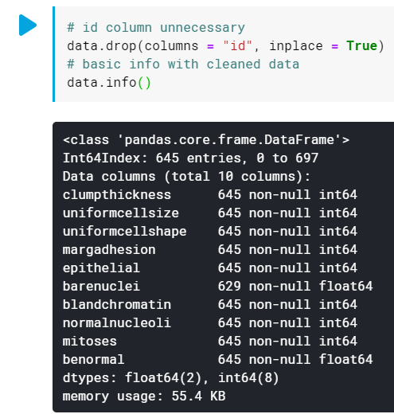
Stage 2: Get the Data
Where did we get the data?
Kaggle
How did we prepare the data?
Removed ID column
Mapped benormal values to 0 or 1

Slide 4
Stage 2: Cleaning
How did we clean the data?
Changed missing ? data to NaN values
Dropped all entries with NaN (16)
Changed all data to numeric values
Removed duplicate rows

Slide 5
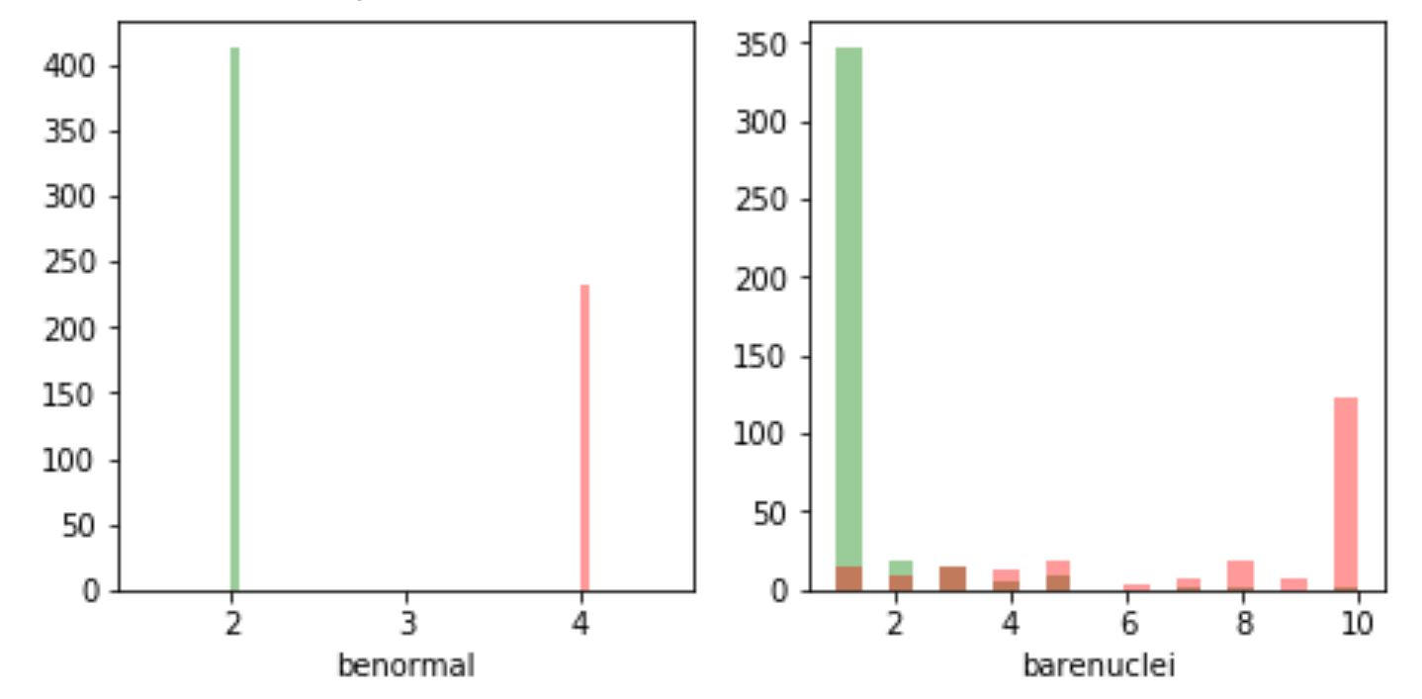
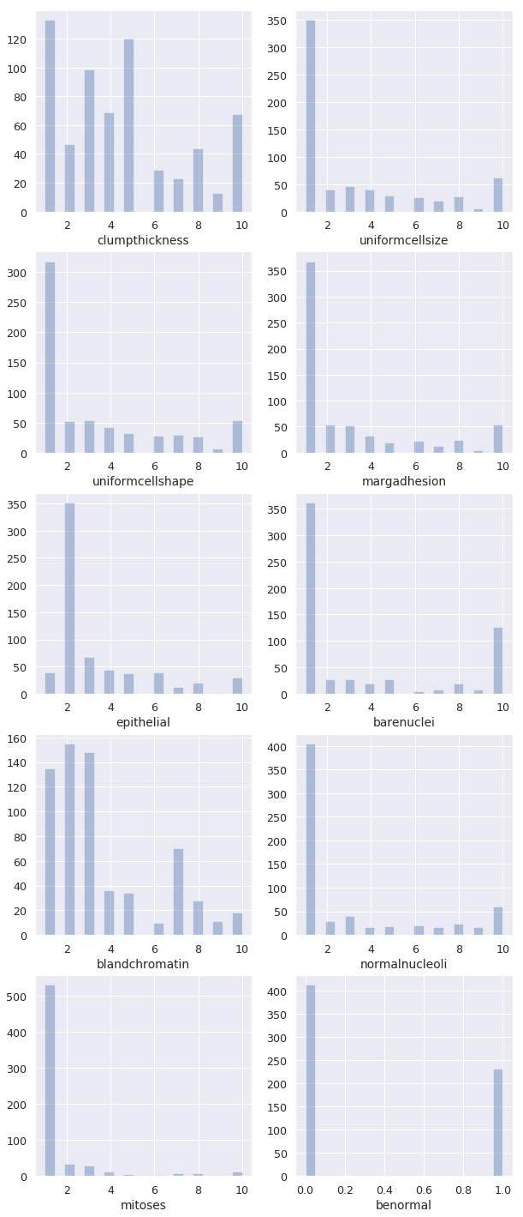
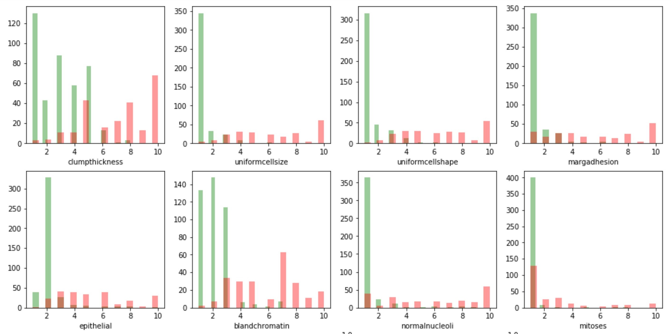
Stage 3: Explore the Data: Variable Frequency Histograms

Slide 6
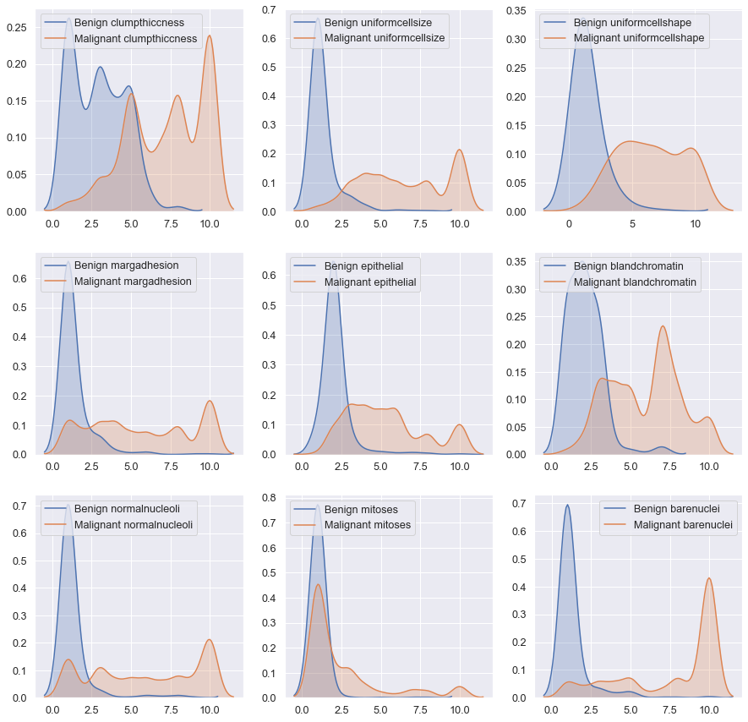
Stage 3: Explore the Data: Density Probability Plots
Benign Tumours appear to be right-skewed in all cases.
Malignant Tumours have more sporadic traits

Slide 7
Clump Thickness
Benign tumours tend to be less thick than malignant tumours
Some overlap in the center

Slide 8
Cell Size Uniformity
Benign tumours tend to have uniform cell sizes
Malignant tumours can vary, but seem to not have uniform cell sizes to some degree or higher

Slide 9
Cell Shape Uniformity
Benign tumours tend to be more uniformly shaped
Malignant tumours have a roughly normal distribution of shape uniformity. They seem to generally not be of the same shape.

Slide 10
Marginal Adhesion
Benign tumours tend to not exhibit high levels of marginal adhesion. Right-Skew
Malignant tumours have a relatively level distribution of marginal adhesion
Note: Small modal peak at 10

Slide 11
Epithelial Cells
Benign tumours tend to contain less epithelial cells
Malignant tumours seem to have some degree of epithelial cells

Slide 12
Bland Chromatin
Benign tumours generally have less bland chromatin, exhibiting an extreme right-skewness
Malignant tumours seem to have modal peaks around 3, 7, and 10. Overall, malignant cells tend to exhibit more bland chromatin

Slide 13
Normal Nucleoli
Benign tumours seem to almost always have relatively normal nucleoli
Malignant tumours have a relatively level distribution of nucleoli normality

Slide 14
Mitoses
Benign and Malignant tumours tend to exhibit similar rates of mitosis
Some malignant tumours exhibit higher rates of mitosis

Slide 15
Bare Nuclei
Benign tumours tend to have less bare nuclei
Malignant tumours seem to have a large amount of completely bare nuclei
Note: some malignant values are lower, but not many

Slide 16
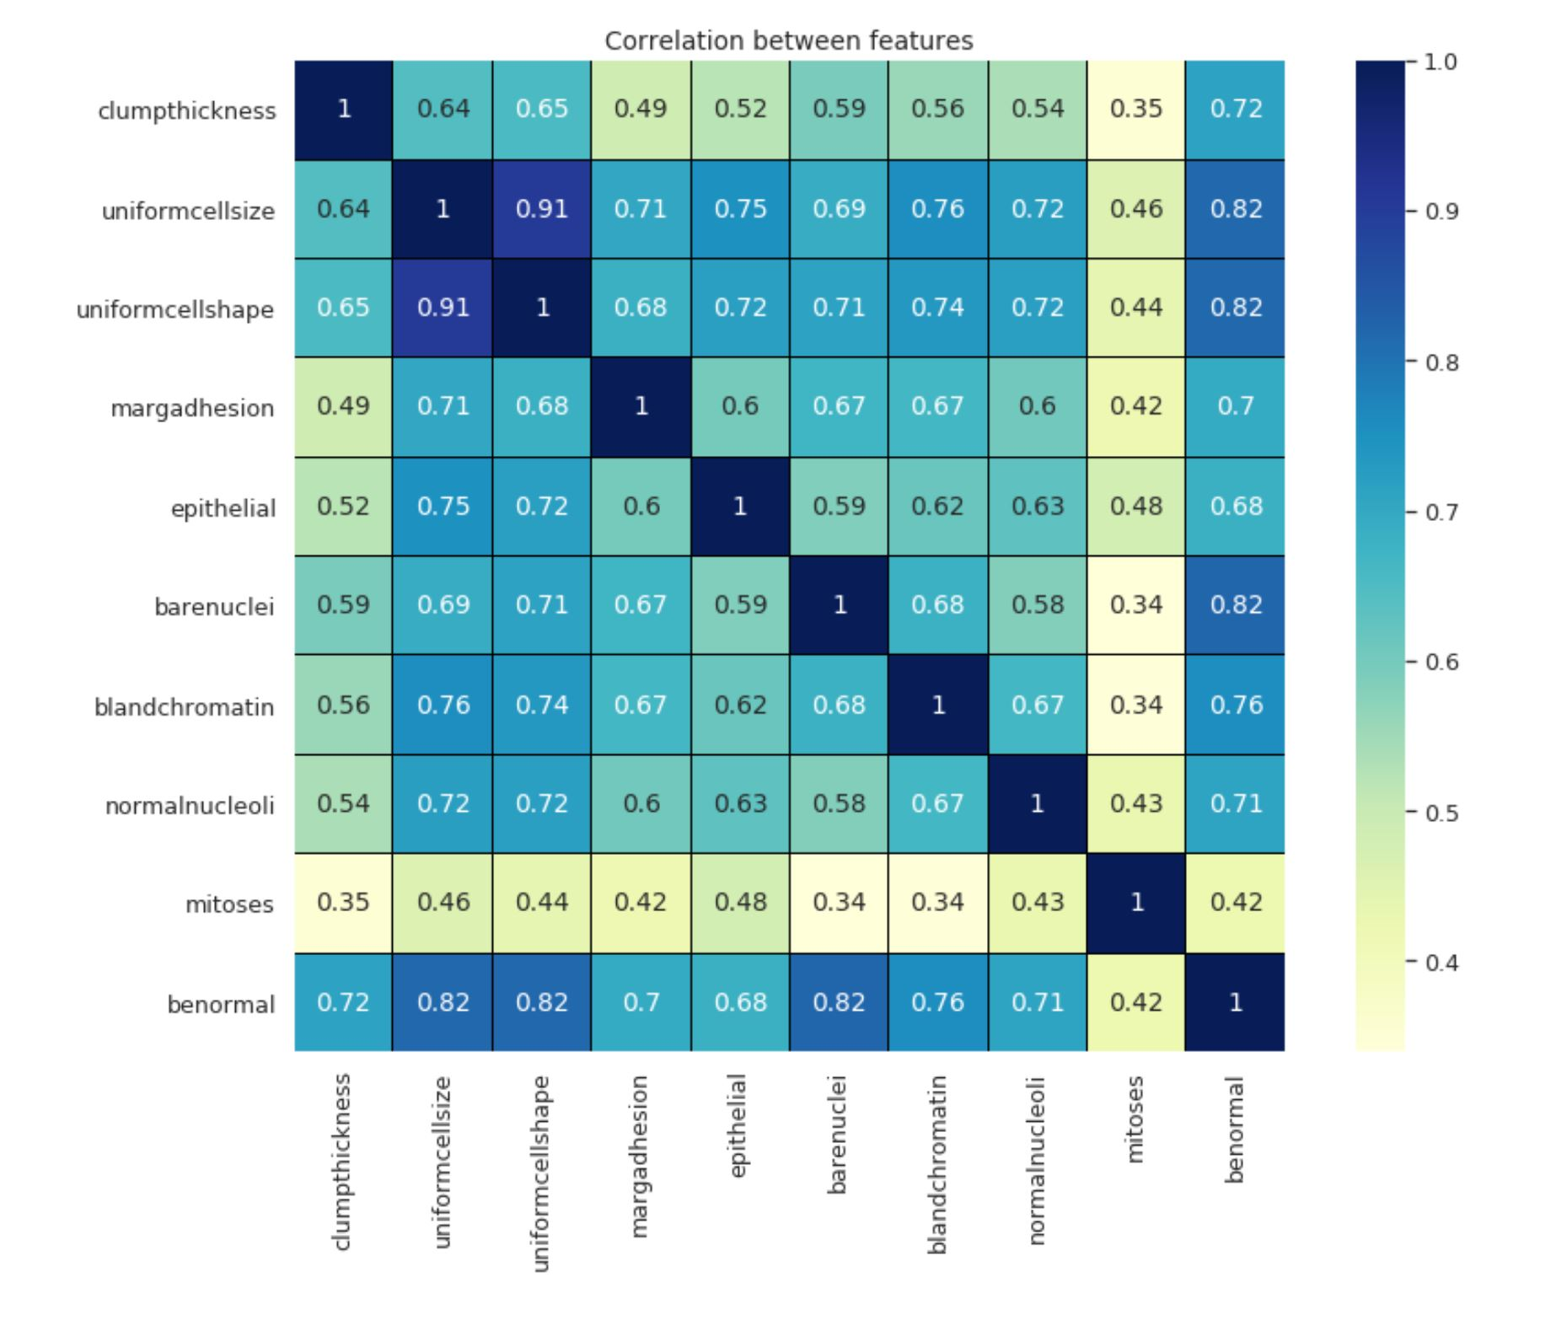
Stage 3: Explore the Data: Seaborn Heatmap
Cell size and shape have the strongest correlation, and strong correlations with all other traits except mitosis
The remainder of the variables only have a moderately strong correlation with each other
Mitosis has the weakest correlations
Note: Very strong correlations between cell size and shape, and bare nuclei with benormal

Slide 17
Machine Learning
Our Process

Slide 18
Model Choice
KNN Decision tree
<100k samples labeled data
Multiple features
Numeric features Categorical target

Slide 19
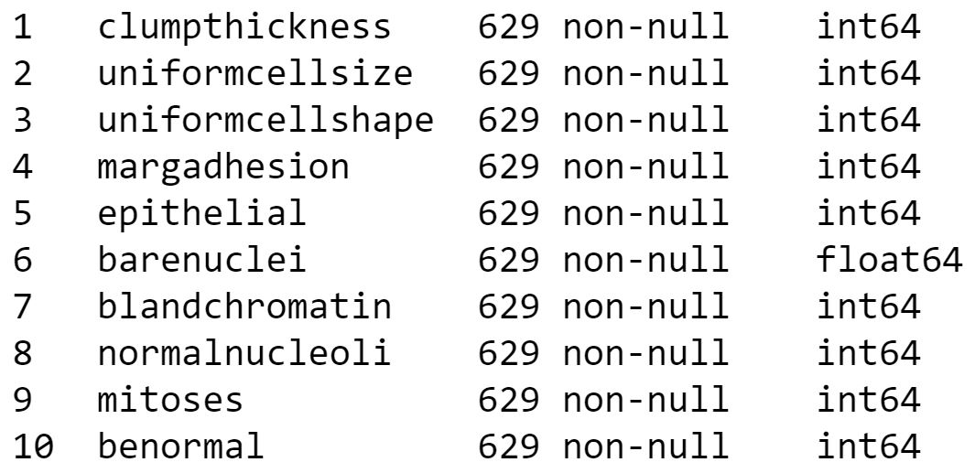
KNN Setup
Used a Train Validation Test split of 70%, 15%, 15%
The random state was 42

Slide 20
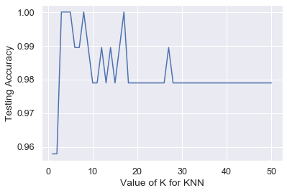
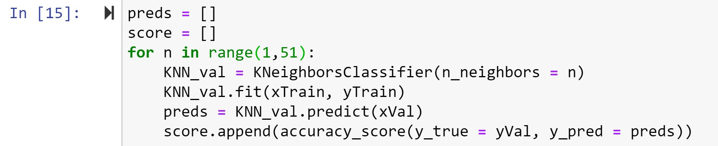
KNN Result
Achieved highest accuracy of 100%
Accuracy was highest with 6 neighbors.
Testing on test set achieved 96.8% Accuracy
This is a reliable model

Slide 21
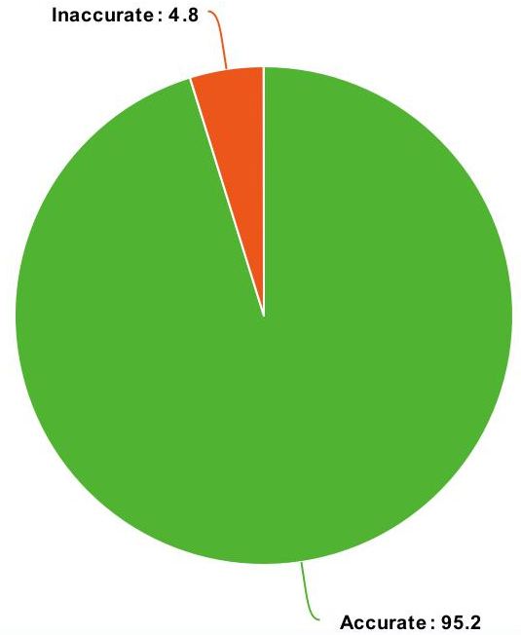
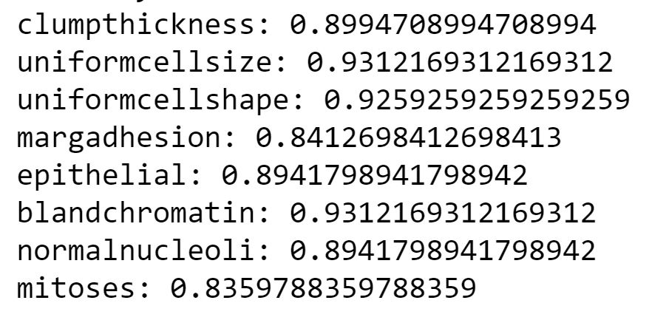
Decision Tree Results
Individual Accuracy
Used a Train Test split of 70%, 30%
The random state was 42
Accuracy of 95.2%

Slide 22
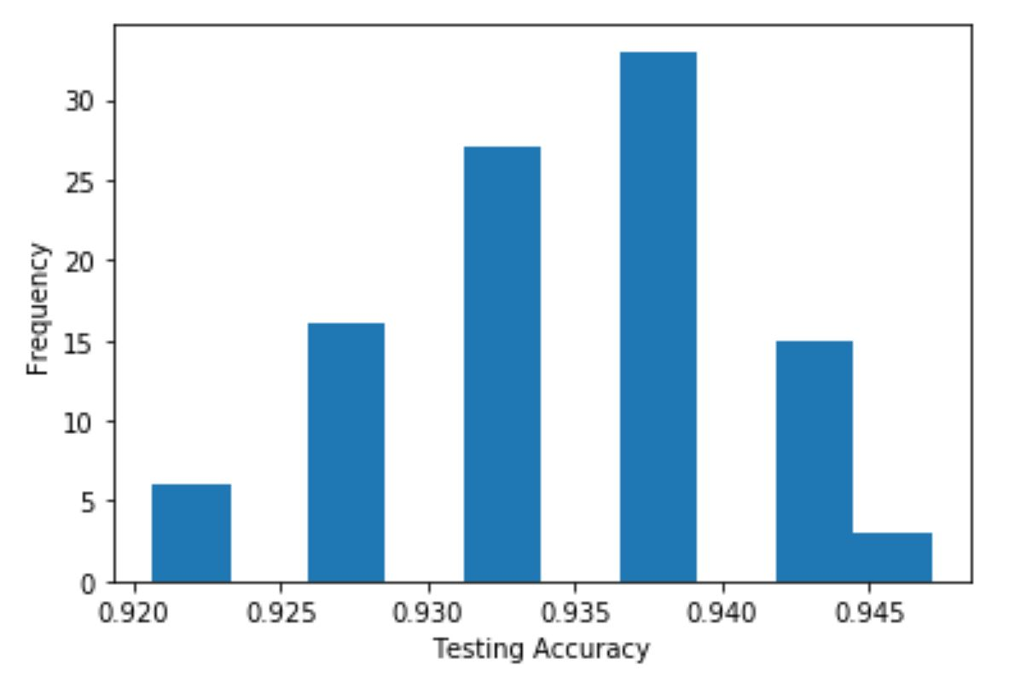
Decision Tree Validation
Removed random state and ran 100 times
Highest accuracy of 94.7%
Lowest accuracy of 92%
Results had low variability

Slide 23
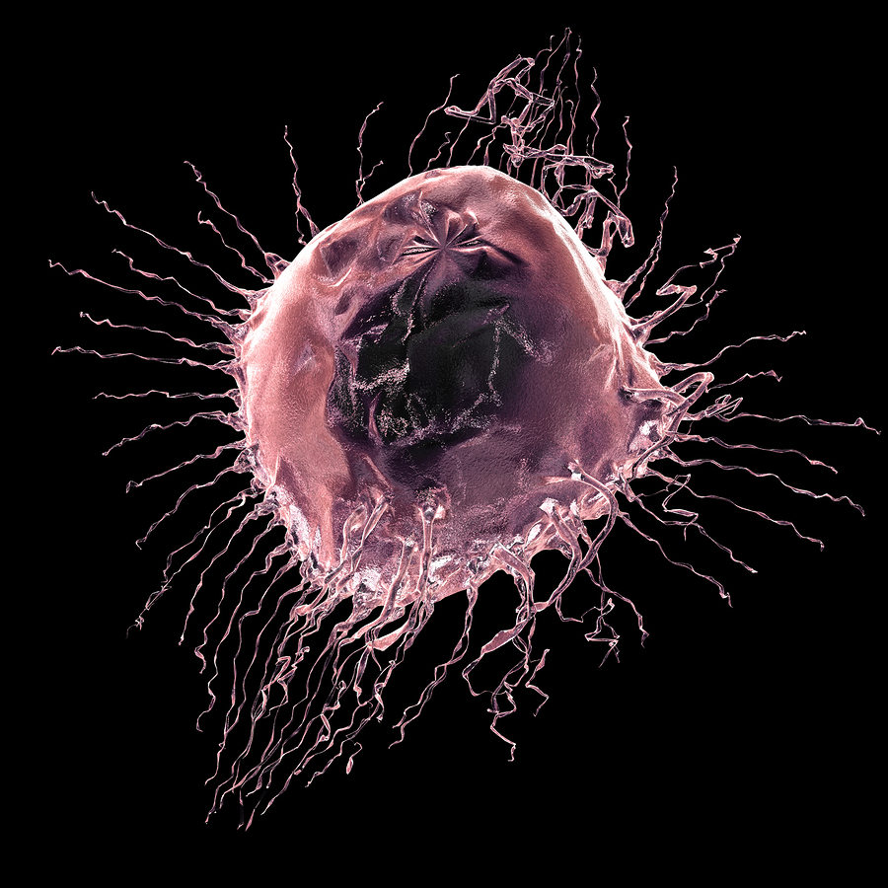
Conclusions and Impact
Of KNN and Decision Tree, KNN performed the best with an accuracy of , but they both scored high accuracies
Uniform cell size and blandchromatin had the highest correlation for predicting cancer type while mitosis had the lowest correlation
Experts estimate that as high as 31% of breast cancer cases may be misdiagnosed. (1)
Tests results for features used in these models to better diagnose a tumor’s benormality and decide treatment
A mammalian breast cancer cell, picture found at health.harvard.edu (2)

Slide 24
Sources Cited
Data provided by Dr. WIlliam H. Wolberg (physician) University of Wisconsin Hospitals Madison, Wisconsin, USA
Bleyer, Archie, and H. Gilbert Welch. “Effect of Three Decades of Screening Mammography on Breast-Cancer
Incidence.” New England Journal of Medicine, vol. 367, no. 21, 2012, pp. 1998–2005.,
doi:10.1056/nejmoa1206809.
https://www.nejm.org/doi/full/10.1056/NEJMoa1206809
Fazio, Sara. “Untangling the Non-Invasive Breast Cancer Controversy.” Harvard Health Blog, Harvard Health
Publishing, 17 Sept. 2015,
www.health.harvard.edu/blog/untangling-the-non-invasive-breast-cancer-controversy-201509188293.

